Slide 1


D&D Healthcare Predictive Patient Flow Analytics
Using Supervised ML Methods to augment intelligent dashboards in Healthcare
Gary Hutson – Head of Solutions and AI / ML
Email: gary@draperanddash.com
Twitter: @StatsGary

Slide 2


About D&D
D&D Healthcare Predictive Patient Flow Analytics
Draper & Dash Healthcare (D&D) is a London based Venture Capitalist (VC) backed healthcare AI and Machine learning predictive data and analytics company. We leverage data from the public sector and private healthcare companies both nationally and globally. We have been providing organisations with solutions that improve quality, safety, outcomes, efficiencies and opportunities.
Over the years we have worked with over 70 healthcare providers in the UK, US and Australia, helping them to drive cost improvements, form new strategic partnerships, improving health outcomes and more.
The Solution
D&D’s solutions give hospitals and healthcare facilities the analytical insight needed to improve patient care and flow throughout the organisation. D&D customers can ensure processes run as efficiently as possible whilst highlighting further improvements and cost-saving opportunities.
Draper & Dash is a provider of operational patient flow, predictive analytics and insights software. Our platform is an intrinsic part of how hospitals and healthcare providers run their organisations on a daily basis and is not an optional add-on but rather a fundamental patient flow tool.
www.draperanddash.com

Slide 3
Technology and
Products
D&D Healthcare Predictive Patient Flow Analytics
Where are the NHS at relating to Data Science and Machine Learning?
Aim for the NHS to be the world leader in artificial intelligence and machine learning within 5 years (https://www.england.nhs.uk/2019/06/nhs-aims-to-be-a-world-leader-in-ai-and-machine-learning-within-5-years/).
Lots of great work happening locally and statistical research published in BMJ, EMJ, etc. However, there is no central function in the NHS to drive this presently.
Use cases of advances and leading the way regarding AI and ML:
Addenbrooke hospital in Cambridge is using Microsoft’s InnerEye system to automatically process scans for patients with prostate cancer
Google’s DeepMind firm has been working with Moorfield's Eye Hospital NHS Foundation Trust since 2016 to help clinicians improve the way serious eye conditions are diagnosed and treated. See: https://deepmind.com/applied/deepmind-health/working-partners/health-research-tomorrow/moorfields-eye-hospital-nhs-foundation-trust/
The rise of programming and data science communities for programming in R. The NHS has its own NHS-R Community (https://nhsrcommunity.com/).
Visit our website to find out more about our solutions
www.draperanddash.com

Slide 4
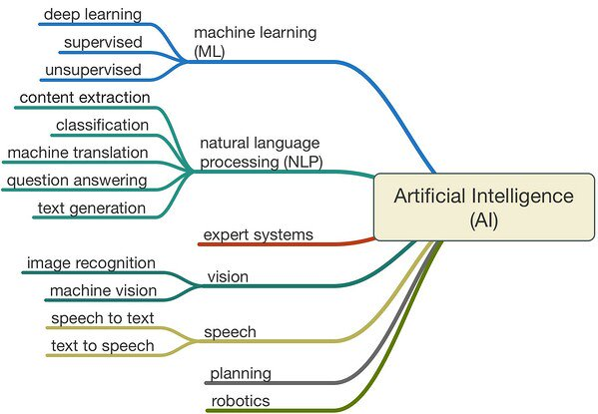
Technology and
Products
D&D Healthcare Predictive Patient Flow Analytics
Where D&D currently sits on the AI branch
Visit our website to find out more about our solutions
www.draperanddash.com

Slide 5
Technology and
Products
D&D Healthcare Predictive Patient Flow Analytics
Aim and objectives
The aim being:
to augment the historic descriptive analytics with prospective (forward looking) solutions.
In addition, to use our in house ML pipeline support the training, testing and production of our supervised ML models.
The objectives:
to allow services and healthcare partners to have advanced warning of prospective system blockages / capacity shortfalls, etc.
Provision of useful tools that can be replicated across the healthcare landscape
Great value decision making tools to aid with effective and smarter working
Visit our website to find out more about our solutions
www.draperanddash.com

Slide 6

D&D Healthcare Predictive Patient Flow Analytics
Stranded Dashboard in focus
www.draperanddash.com

Slide 7
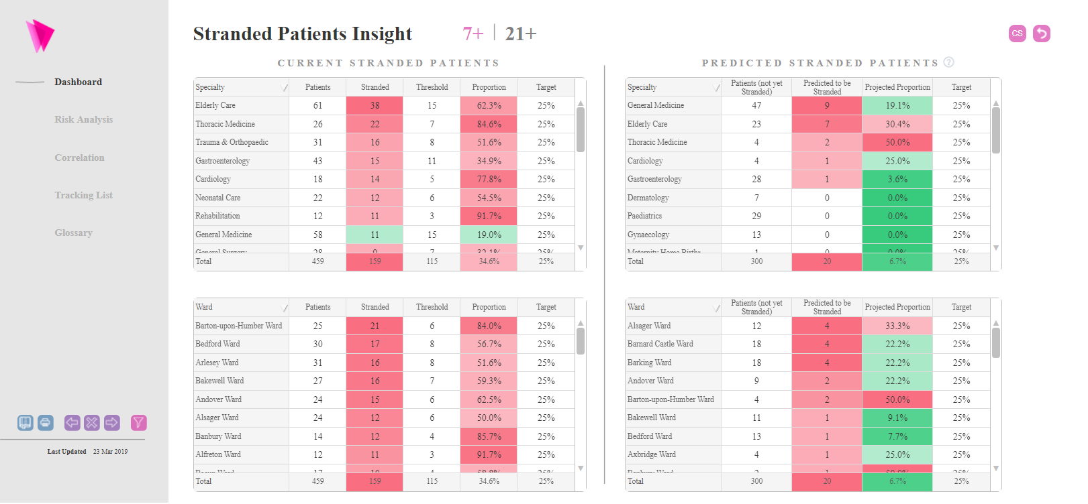
Technology and
Products
D&D Healthcare Predictive Patient Flow Analytics
Dashboard view
Visit our website to find out more about our solutions
www.draperanddash.com

Slide 8
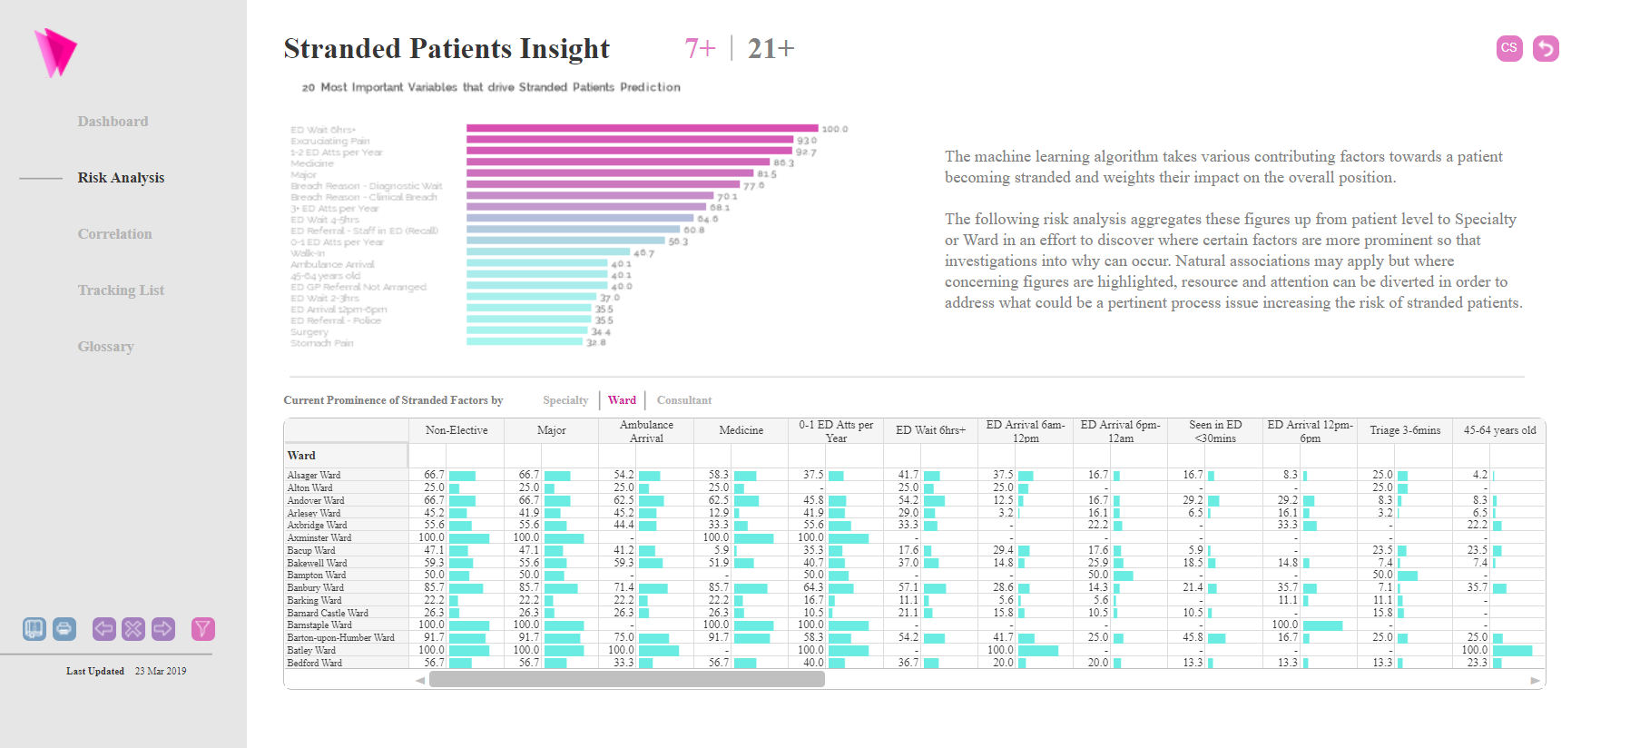
Technology and
Products
D&D Healthcare Predictive Patient Flow Analytics
Insights view
Visit our website to find out more about our solutions
www.draperanddash.com

Slide 9
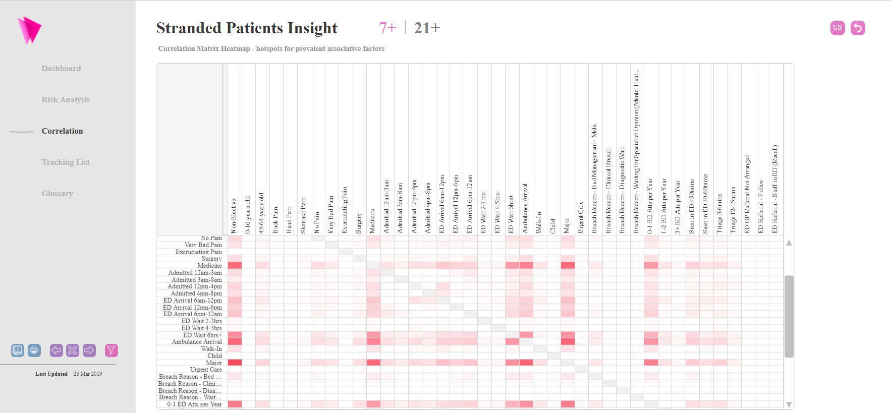
Technology and
Products
D&D Healthcare Predictive Patient Flow Analytics
Correlation view
Visit our website to find out more about our solutions
www.draperanddash.com

Slide 10
D&D Healthcare Predictive Patient Flow Analytics
Our steps to designing the R ML model
www.draperanddash.com

Slide 11
Technology and
Products
D&D Healthcare Predictive Patient Flow Analytics
What’s does the fusion of ML and BI allow us to do?
As you saw from the previous slides, we can fuse our in house data science with expertise with our development teams knowledge of Qlik and other BI solutions to:
Build, train, evaluate and deploy custom ML models for the needs of the relevant dashboard
Build custom and generic solutions to any healthcare problem
Create forward facing solutions, instead of the traditional rear view mirror approaches to healthcare analytics
Create ‘what if’ models to allow services and functions within the NHS to generate predictions based on smart filtering
Leverage the power of R and our BI solutions to their fullest potential. R has been adopted as our core development language as there is a powerful community within NUH
Aim to adopt a platform agnostic approach to developing solutions
Visit our website to find out more about our solutions
www.draperanddash.com

Slide 12
Technology and
Products
D&D Healthcare Predictive Patient Flow Analytics
Supervised ML algorithms – development process
Generally, our first rule of thumb is to think about the problem we are trying to solve.
Think about how the problem, how this could be an issue to other healthcare providers and will the problem be the same in other areas
Agree on the approach – whether this be supervised (regression / classification), unsupervised or more deep methods such as neural nets
Think about how to evaluate the model, how the data is going to be partitioned (cross validation, hold out, etc.), for classification understand and adjust for class imbalance
Start with the data, feature encode, clean and prepare the data and work closely with the BI development team to make sure the underlying datasets do not change, or the problem domain has not shifted
Choose the right algorithm for the task, use multiple algorithms and benchmark the accuracy (or other performance metrics) against, or evolve this over time. Usually, our data science team knows what models to use for the purpose – this comes with experience
Train the model
Test the model – regression (RMSE) and classification (confusion matrices) by making predictions using model coefficients / rules
Improve the model
Deploy the model
Visit our website to find out more about our solutions
www.draperanddash.com

Slide 13
Technology and
Products
D&D Healthcare Predictive Patient Flow Analytics
Supervised ML algorithms – first phase – problem definition
What is the problem?
Informal description – design it from a friend or colleagues viewpoint. For example “I need a solution that will identify stranded patients”.
Look for similar problems
Why does the problem need to be solved?
Examine:
Motivation – what is the motivation for solving the problem
Solution benefits – what will be the espoused benefits of the solution
Use – how will this be used in practice
How would you (sentient being) solve the problem?
If I were to do this manually – how would it work?
What is the problem?
Why does the problem need to be solved?
How would I (a sentient being) solve the problem?
Visit our website to find out more about our solutions
www.draperanddash.com

Slide 14
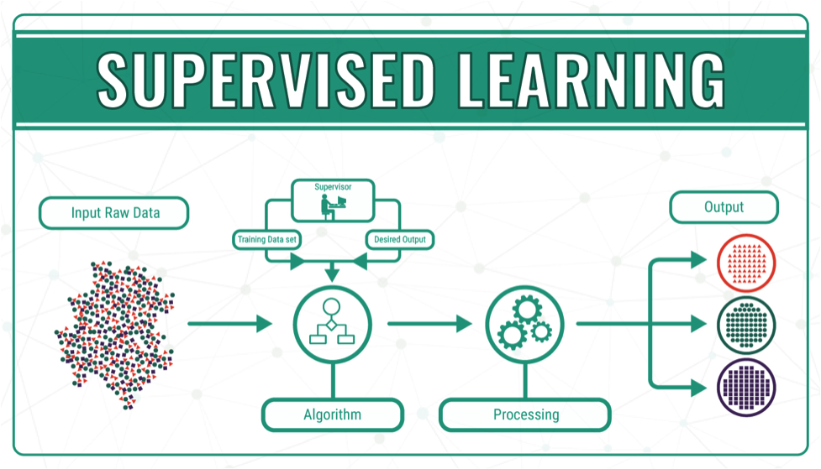
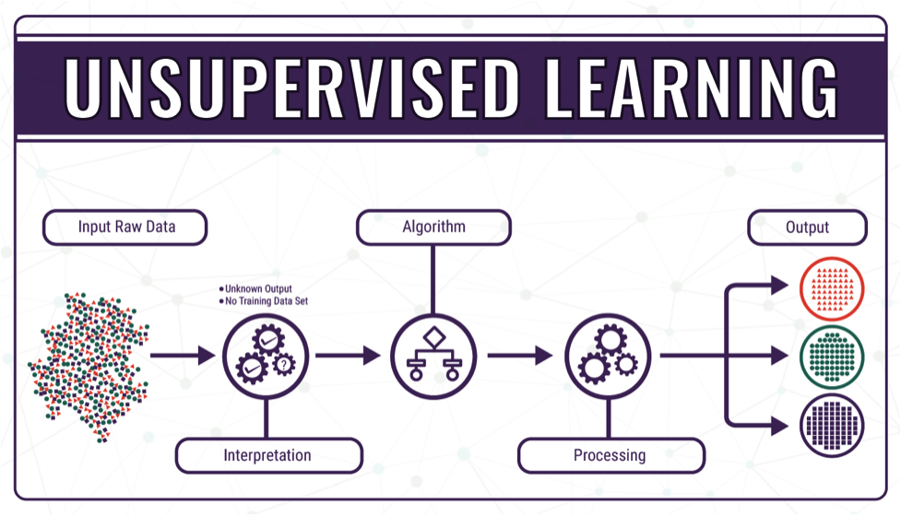
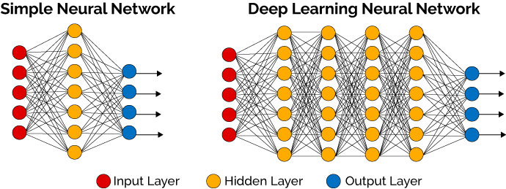
Technology and
Products
D&D Healthcare Predictive Patient Flow Analytics
Supervised ML algorithms – second phase – approach
Visit our website to find out more about our solutions
www.draperanddash.com

Slide 15
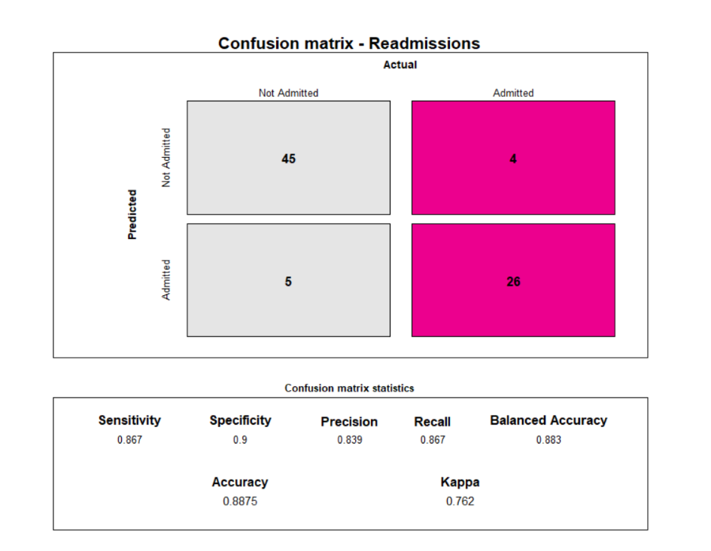
Technology and
Products
D&D Healthcare Predictive Patient Flow Analytics
Supervised ML algorithms – third phase – plan for evaluation
Evaluation
Confusion matrices – these are our go to for evaluating our classification models. We have developed a nice confusion matrix function in R: https://www.draperanddash.com/machinelearning/2019/07/confusion-matrices-evaluating-your-classification-models/
Packaged up and ready to use. The above link gives you the information needed to evaluate a binary classification problem. A multiclass version is currently in development.
Regression – I tend to like to compare Root Mean Squared Error or MAPE to compared regression models – with the lowest RMSE (https://www.statisticshowto.datasciencecentral.com/rmse/) or MAPE indicating the best fit. Akaike Information Criterion (AIC) is another way to compare models (https://en.wikipedia.org/wiki/Akaike_information_criterion)
Visit our website to find out more about our solutions
www.draperanddash.com

Slide 16
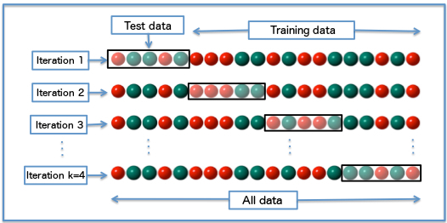
Technology and
Products
D&D Healthcare Predictive Patient Flow Analytics
Supervised ML algorithms – third phase – plan for evaluation (cont.)
Data partitioning
Training and test set splits
Training, test and validation set splits
K fold cross partitioning (K=10 is our default) then resample to compare accuracy of subsamples
Class imbalance
Use SMOTE to under or over sample – R has an implementation here: https://www.rdocumentation.org/packages/DMwR/versions/0.4.1/topics/SMOTE
Visit our website to find out more about our solutions
www.draperanddash.com

Slide 17

Technology and
Products
D&D Healthcare Predictive Patient Flow Analytics
Supervised ML algorithms – fourth and sixth phase – choosing algorithm(s)
Choosing algorithm
Decide whether you want a probabilistic approach, a classification approach or a regression approach to your ML model
For classification, our go to is the Caret package. See this list for the available packages in caret (classification and regression training) package: https://rdrr.io/cran/caret/man/models.html
Why CARET?
The main reason is that it provides a consistent framework for training and evaluating machine learning models in R. We have created a template function which allows any caret supported model to be passed and it returns all the key information as a list of outputs. If this template was not available, then this would become more difficult.
Visit our website to find out more about our solutions
www.draperanddash.com

Slide 18
Technology and
Products
D&D Healthcare Predictive Patient Flow Analytics
Supervised ML algorithms – fifth phase – getting the data in the right shape
To get the data in the right shape and encode our features in the right way we use a number of different packages:
Data Import – R has numerous packages for data import. These are some of the most popular packages: readr (comma separated data), readxl (import Excel). Haven (read outputs from other stats packages such as SPSS), httr (read elements from website – normally html tables), rvest (web scraping), xml2 (xml file structure reading) and RODBC (for reading in database data)
Data Cleaning – for data cleaning and transformation: tidyr (tidys data and allows multiple row and column wise operations), dplyr (all things data transformation – joining data, summarising data, renaming and adding columns, etc.), forcats (package for working with factors), hms (time formatting package), lubridate (date and time manipulation package) and stringr (string matching and formatting)
Bucketing categorical variables – to retain control – we tend to do this with dplyr using the case_when() syntax with the creation of new columns (mutate)
This part of the process is the most labour intensive and involves careful consideration with our business intelligence – who generally create the visuals for the dashboards. Both dashboard and algorithm need to be in sync
Visit our website to find out more about our solutions
www.draperanddash.com

Slide 19
Technology and
Products
D&D Healthcare Predictive Patient Flow Analytics
Supervised ML algorithms – seventh to eighth phase– train, predict and evaluate model
Train model
Train the goal variable, or variables, with the relevant ML algorithm of choice. For the stranded – we used a Naïve Bayes and a regression tree to produce the probability estimates.
Predict
Use held back data (test / validation) data to make predictions – these could be classifications or numerical predictions (regression results). The native predict() command deals with the predictions – see my previous talk on implementing this: https://nhsrcommunity.com/wp-content/uploads/2019/01/Using-R-to-predict-admission-into-ED-NHS-R-Event-Gary-Hutson.pdf
Evaluate the model
We previous saw that we have created a custom confusion matrix for evaluation of the models. Please refer to this link, as it provides you with all the narrative around the performance benchmarks as well.
ROC curves can also be used, for classification, see for https://cran.r-project.org/web/packages/pROC/pROC.pdf
Visit our website to find out more about our solutions
www.draperanddash.com

Slide 20
Technology and
Products
D&D Healthcare Predictive Patient Flow Analytics
Supervised ML algorithms – ninth phase – improve the model
Explore bagging algorithms in R – these are ensemble methods such as bag of trees and random forests – which use a voting mechanism and data sampling logic – to improve accuracy and pattern detection. However, can be computationally expensive with larger datasets
Explore boosting models – gradient boosting machines (GBM) have a great implementation in R: https://datascienceplus.com/gradient-boosting-in-r/
Stacking algorithms – I use these a lot, as it allows you to stack a family of algorithms together and these models are then used to improve the results of the predictions (see implementation on next slide). Stacking, also known as stacked generalization, is an ensemble method where the models are combined using another machine learning algorithm. The basic idea is to train machine learning algorithms with training dataset and then generate a new dataset with these models. Then this new dataset is used as input for the combiner machine learning algorithm.Look for obvious issues – overfitting, underfitting, dependence in factors, etc.
Partition your data differently to see if this improves the accuracy output
Add more data
Scaling (scale() R function) and feature transformation
Feature selection and deselection
Algorithm tuning – adjust model parameters – for random forests this could be the number of trees grown, etc. Iterate through to hyperparameter tune in code
Visit our website to find out more about our solutions
www.draperanddash.com

Slide 21
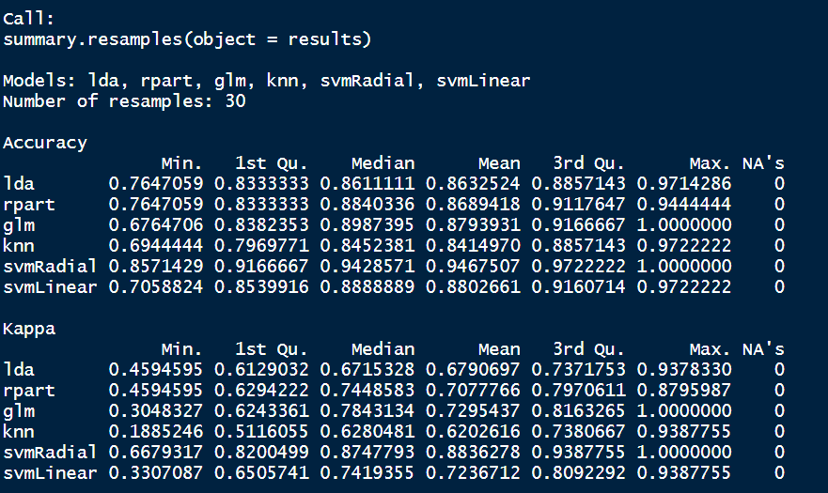
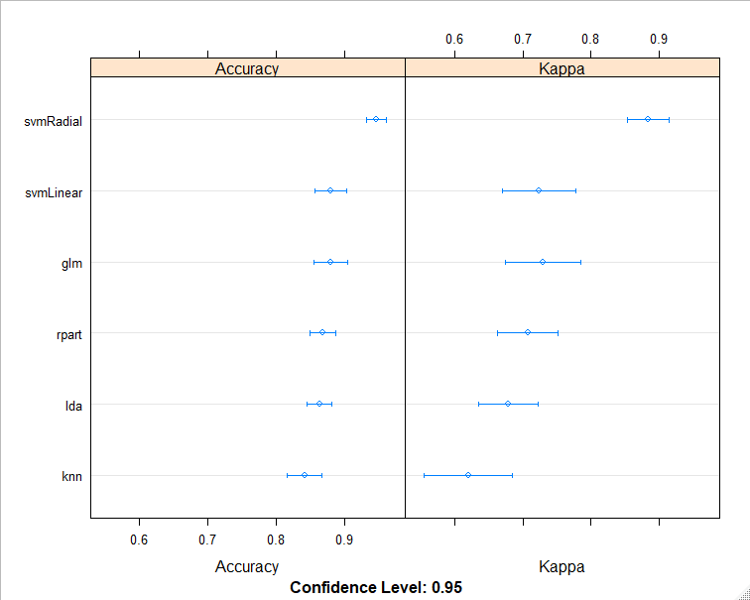
Technology and
Products
D&D Healthcare Predictive Patient Flow Analytics
Supervised ML algorithm Improvement -
stacking implementation in R
#Generate list of algorithms and train the multiple models with multiple resamples using the caretList function
Library(caret); library(caretEnsemble)
seed <- 123
train_ctl <- trainControl(method="repeatedcv", number=10, repeats=3,savePredictions = TRUE,
classProbs=TRUE)
algo_list <- c('lda', 'rpart', 'glm', 'knn', 'svmRadial', 'svmLinear')
set.seed(seed)
class_name <- "Class"
models <- caretList(as.formula(paste(class_name, "~ .")),
data=dataset, trControl=train_ctl, methodList=algo_list)
models
results <- resamples(models)
summary(results)
dotplot(results)
Full code:https://github.com/StatsGary/stacking_ML_code/blob/master/stacking_ML.R
Visit our website to find out more about our solutions
www.draperanddash.com

Slide 22
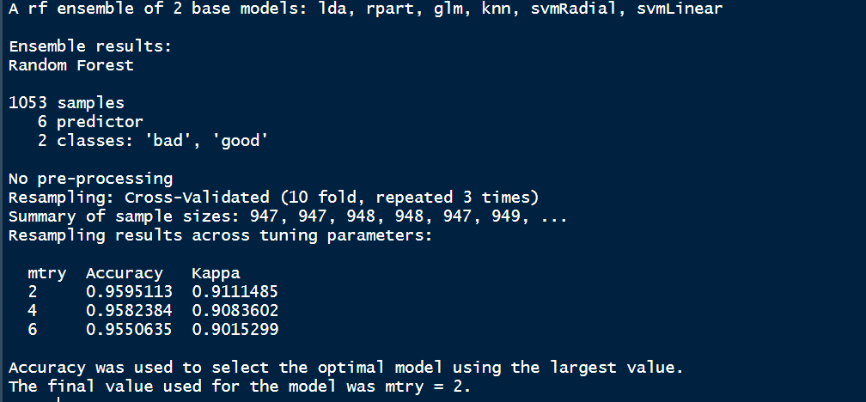
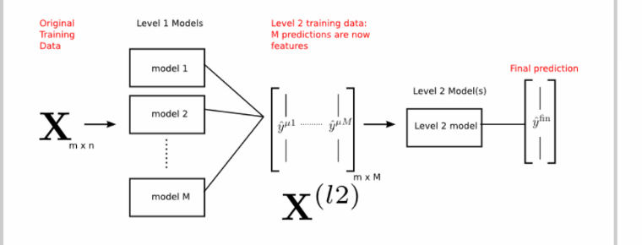
Technology and
Products
D&D Healthcare Predictive Patient Flow Analytics
Supervised ML algorithm Improvement –
stacking implementation in R
Original results
#Use higher order model to improve the results by majority voting for classification
stack_ctl <- trainControl(method="repeatedcv", number=10, repeats=3, savePredictions=TRUE,
classProbs=TRUE)
set.seed(seed)
rand_forest.stack <- caretStack(models, method="rf", metric="Accuracy", trControl=stack_ctl)
print(rand_forest.stack)
Post results using Ensemble
Visit our website to find out more about our solutions
www.draperanddash.com

Slide 23
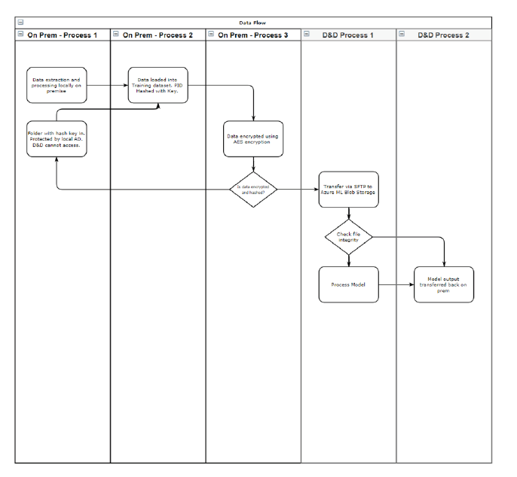
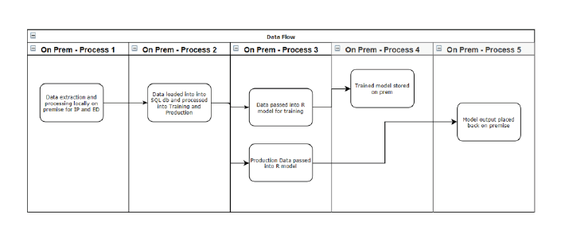
Technology and
Products
D&D Healthcare Predictive Patient Flow Analytics
Supervised ML algorithms – tenth phase – deploy the model
We at D&D have written a blog on how to complete this process: https://www.draperanddash.com/machinelearning/2019/08/deploying-a-trained-supervised-ml-model/
The majority of our solutions are deployed directly on client sites:
Client-Side Process
Azure ML Process
Visit our website to find out more about our solutions
www.draperanddash.com

Slide 24
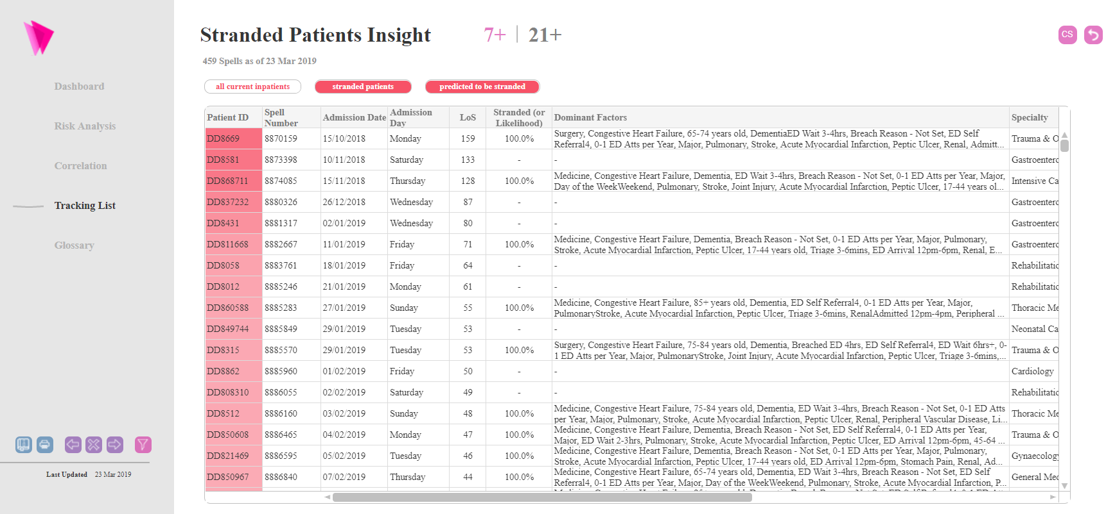
Technology and
Products
D&D Healthcare Predictive Patient Flow Analytics
Outputs from R models
Dominant factor chain string
Stranded likelihood
Visit our website to find out more about our solutions
www.draperanddash.com

Slide 25

Technology and
Products
D&D Healthcare Predictive Patient Flow Analytics
The secret sauce – how do we build our R models
Visit our website to find out more about our solutions
www.draperanddash.com

Slide 26

Thank you
Draper & Dash (D&D)
Contact:
gary@draperanddash.com

